Slide 1





I ♥ Hacker News
@barik
Expanding Qualitative Research Findings by Analyzing Social News Websites
Titus Barik, Brittany Johnson, Emerson Murphy-Hill
Notes:
My name is Titus, and if you didn’t already know, I’m a big fan of Hacker News. Today I’m going to talk to you about our new ideas in using social news websites like Hacker News to help qualitative research conduct their research more effectively and confidently.

Slide 2

Notes:
In industry, we like to say that software problems are people problems.
Quantitative analysis gives us one statistics lens of insight, its through qualitative methods, such as interviews, that we can understand the stories and experiences of software developers and their activities, in a level of richness and detail, that, in opinion, would be otherwise unattainable. That’s the value that qualitative research can bring to the table. It’s the stories of the developers themselves, contextualized in their own words.

Slide 3
Why don’t developers use static analysis tools?
(Johnson and colleagues, 2013)
What makes a great software engineer?
(Li and colleagues, 2015)
What are the practices of agile teams?
(Hoda and colleagues, 2011)
Notes:
Not surprising that these types of social science methods get applied to software engineering research.
Certain types of tools = run in your editor and help you improve your code in many different dimensions, such as using secure APIs.

Slide 4




But it’s really, really hard.
(Hove and Anda, 2005)
Notes:
TODO(tbarik): Change to animation.
Grounded theory
Clerical effort
Connectivity tissue to bind all of these stories
Limited tool support
Expense means that we don’t triangulate. Runnin this pipeline isn’t justifiable..

Slide 5





Our new idea makes it easier.
> 7.5 million
Notes:
Our new idea makes this easier. What we’re really trying to capture these qualitative techniques, such as interviews are these stories. But we don’t just tell stories during interviews. Some cognitive psychology would say that storytelling is actually a fundamentally way in which we understand the world. And our insight is that if you have a large and diverse set, it’s probably that many of these stories have already been told – you just have to look for them. HN has over 7.5 million comments, on a diverse of technical-related topics. That’s an information source that we should leverage, and we should be able to do that significantly easier than our traditional pipeline – either to supplement or to replace.
Tools synthesize and explore these data sets to generate theory.

Slide 6
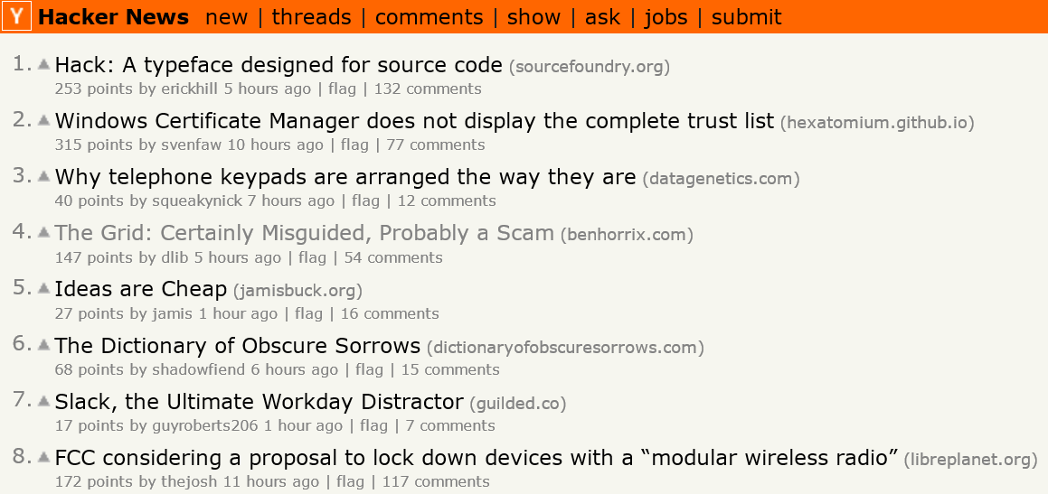
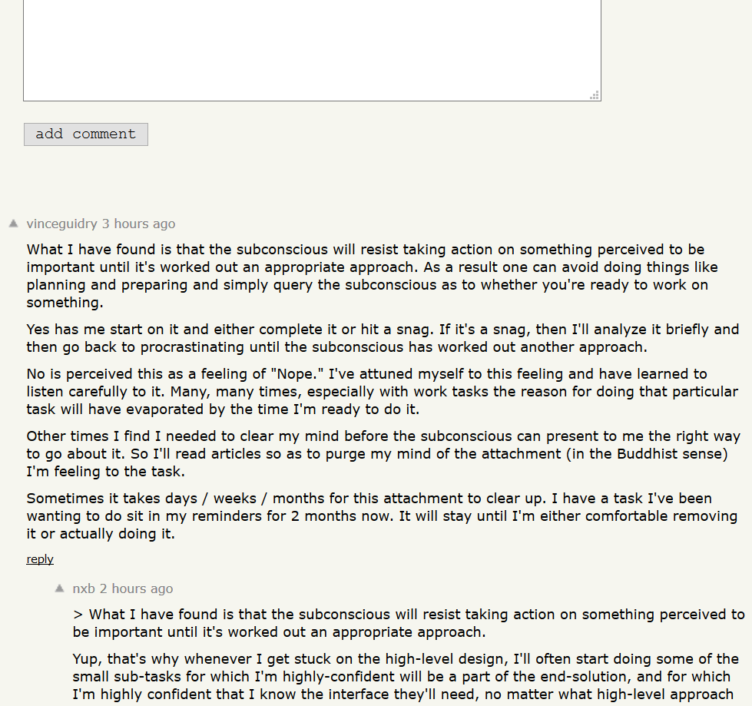
Notes:
Small disgression, context of HN
attracts highly technical audience. → communities
Strict moderation guidelines. Signal/noise
Comment ranking and points system.

Slide 7
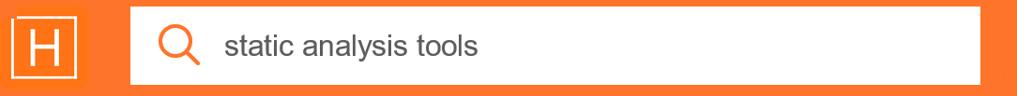

Replication: Why don’t developers use static analysis tools?
Original Study
Hacker News Study
Tool Output
Collaboration
Customization
Tool Output
Collaboration
Customization
Awareness
Cost
Ego
Management
Maintenance
Performance
Security
Notes:
To test the utility of using HN as an information source, replicated the original study.
First-order approximation interview
Programatically, ran search Card sort…. 600 cards, for 100.

Slide 8

“Pretty much SonarQube is the only tool I have found and it's somewhat annoying as a few plugins are commercial and very expensive.” (HN 8568574)
Notes:
Some of the steps for free.

Slide 9




Vision
Phase 0: Provide a graph dataset of HN.
Phase 1: Establish utility of HN for answering software engineering research questions.
Phase 2: Build exploratory tools that enable researchers to interact with social news data sets.
Phase 3: Explore domains such as KDD, NLP, and human topic analysis to provide automation for these tools.
Notes:
Immediate, short term to

Slide 10
Thanks!
@barik
Our new idea is to automatically extract software developer stories from technical, social news websites.
Objective: Build tools to allow qualitative researchers to explore these data sets.
Objective: Provide algorithmic support to assist with these analysis activities.

